Slide 1
IO-Link Master DataLine EoE configuration with ctrlX
Notes:
ifm electronic gmbh

Slide 2
Agenda
Introduction (what we would like to do, what equipment will be used, cabling)
Establish a connection between a PC and ctrlX PLC
Establish a connection between IO-Link Master and ctrlX PLC
Exchange data via EtherCAT protocol
Use EoE (test the connection, webserver, LRD, moneo)
© ifm ecomatic gmbh
Stand: 07.11.26
Seite <number>

Slide 3
Introduction
What would we like to achieve?
  Establish a connection between a PC and ctrlX PLC -> webserver + do configuration
  Establish a connection between IO-Link Master (EtherCAT slave) and ctrlX PLC (EtherCAT master) -> no errors, OP mode
  Exchange data via EtherCAT protocol (EtherCAT master <-> EtherCAT slave) -> can see object values
  Use EtherCAT protocol to transmit TCP/IP traffic between PC and IO-Link Master -> ping, webserver, moneo
What equipment shall be used?
  PC
  EtherCAT Master -> ctrlX
  EtherCAT slave -> IO-Link Master DataLine
© ifm ecomatic gmbh
Stand: 07.11.26
Seite <number>

Slide 4
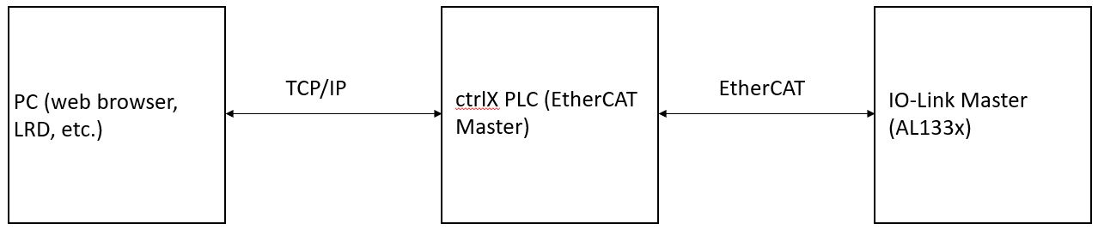
Introduction continuation
Cabling
  Devices shall be connected according to the following schematic
XF50
X21
XF10
© ifm ecomatic gmbh
Stand: 07.11.26
Seite <number>

Slide 5
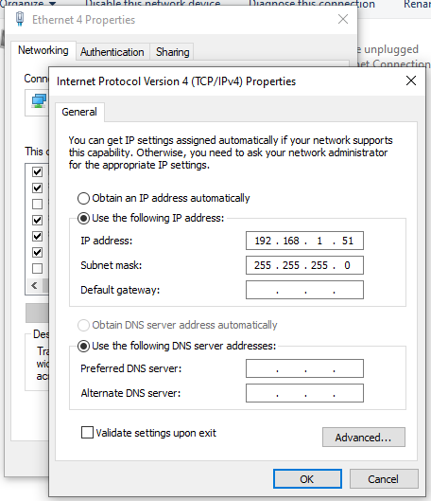
Establish a connection between a PC and ctrlX PLC
In my ctrlX port XF10 has IP address = 192.168.1.1
It is connected with “Ethernet 4” interface in my PC
Ethernet 4 is configured as presented below
© ifm ecomatic gmbh
Stand: 07.11.26
Seite <number>

Slide 6
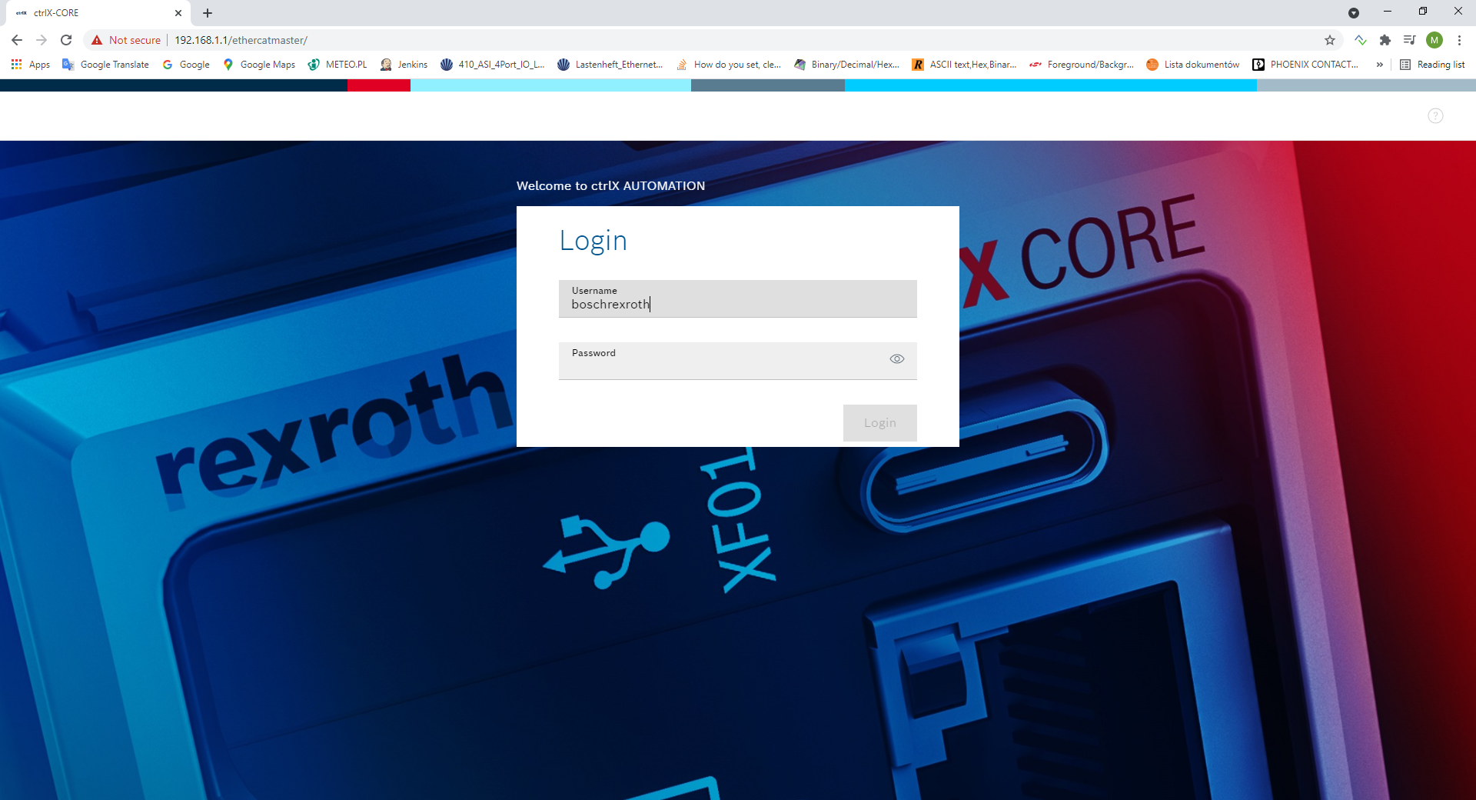
Establish a connection between a PC and ctrlX PLC
With the configuration described on the previous slide we are able to open webserver
© ifm ecomatic gmbh
Stand: 07.11.26
Seite <number>

Slide 7
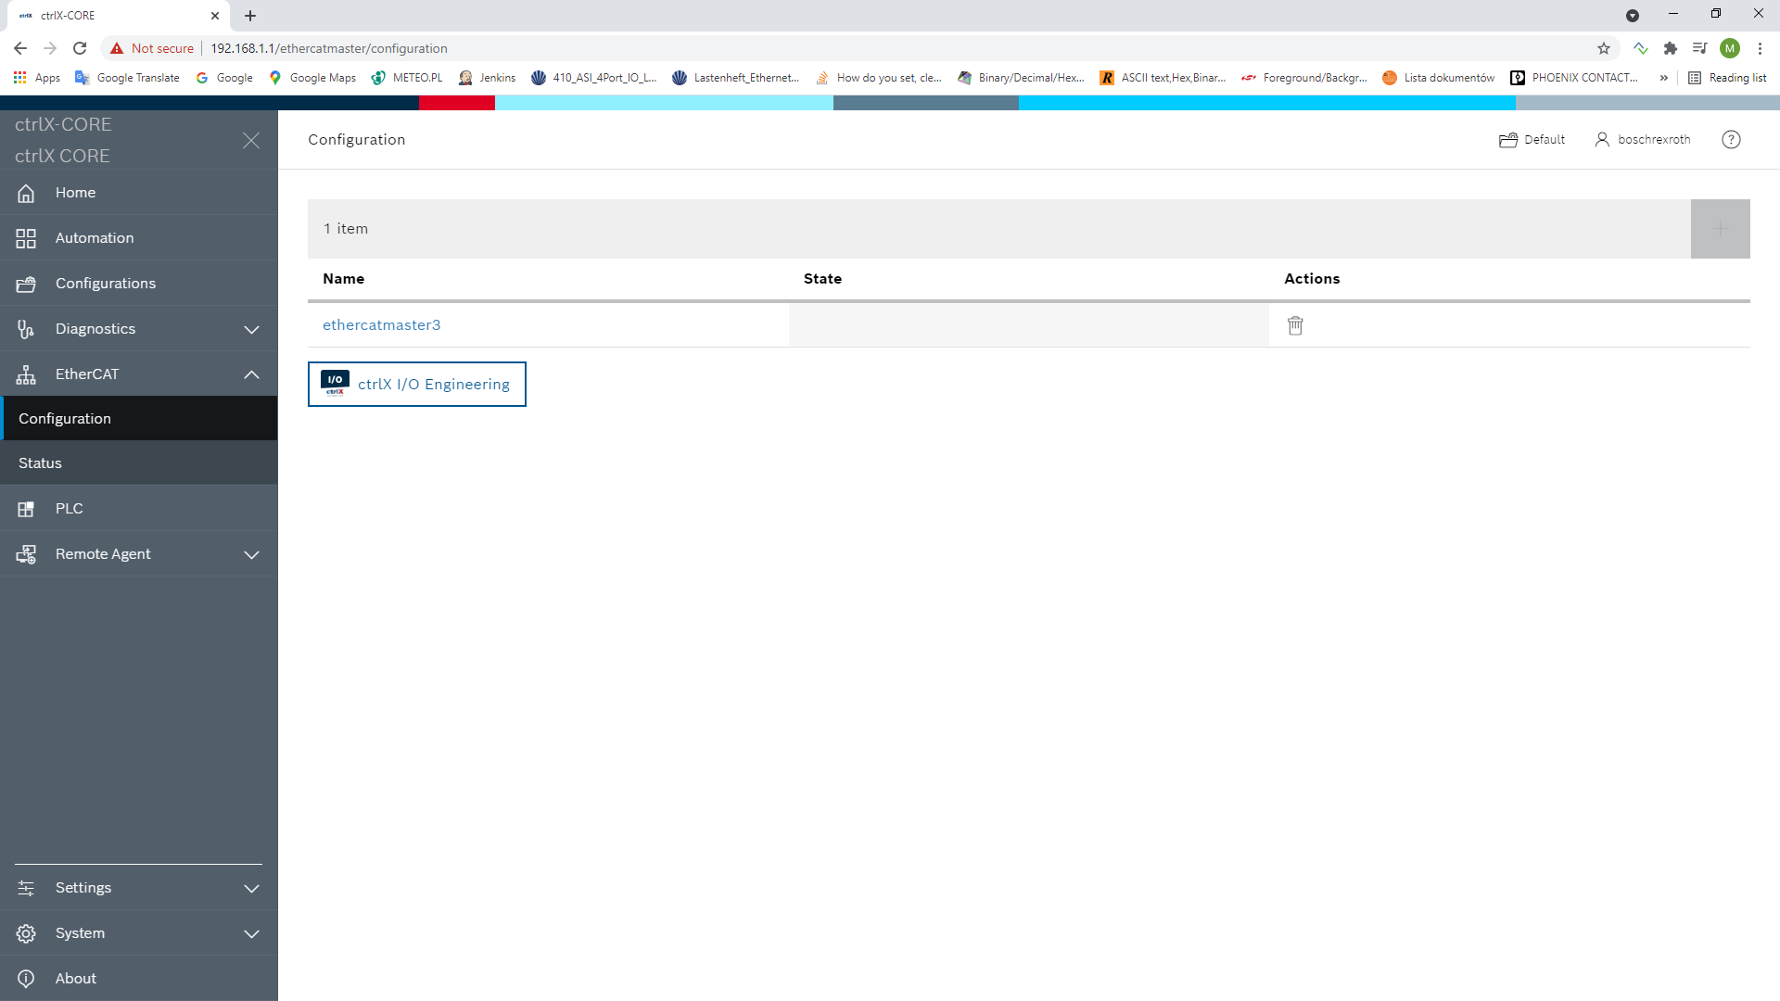
Establish a connection between IO-Link Master and ctrlX PLC
For the purpose of this presentation, we assume that IO-Link Master is in its default settings (right after factory reset was performed)
Cable between ports XF50 and X21 is connected
We start by adding EtherCAT Master in the PLC webserver
© ifm ecomatic gmbh
Stand: 07.11.26
Seite <number>

Slide 8
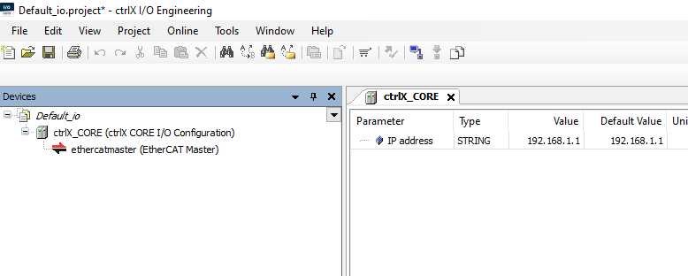
Establish a connection between IO-Link Master and ctrlX PLC
Next, we go to the ctrlX I/O Engineering
EtherCAT Master should be added to the devices tree there
© ifm ecomatic gmbh
Stand: 07.11.26
Seite <number>

Slide 9
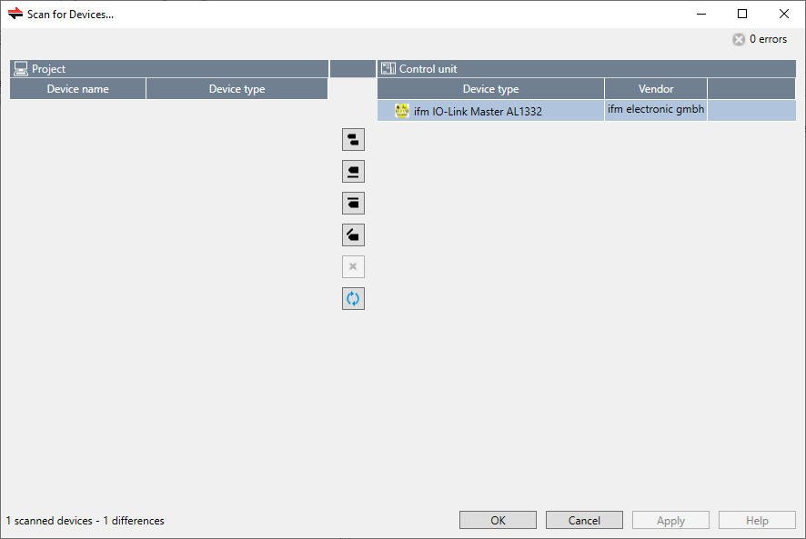
Establish a connection between IO-Link Master and ctrlX PLC
In the ctrlX I/O Engineering we now do “Scan for Devices…” with the following result
ifm IO-Link Master should be now added to the project;
PLEASE NOTE: take care about having up-to-date ESI file in your Device Repository
© ifm ecomatic gmbh
Stand: 07.11.26
Seite <number>

Slide 10
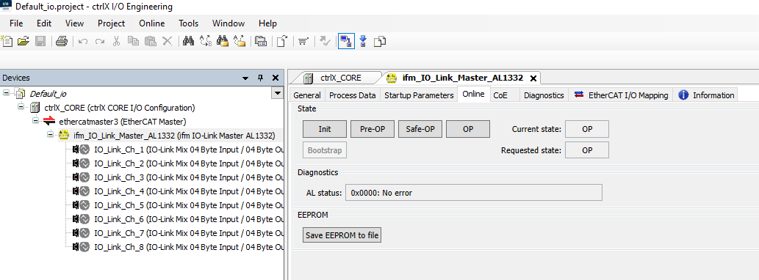
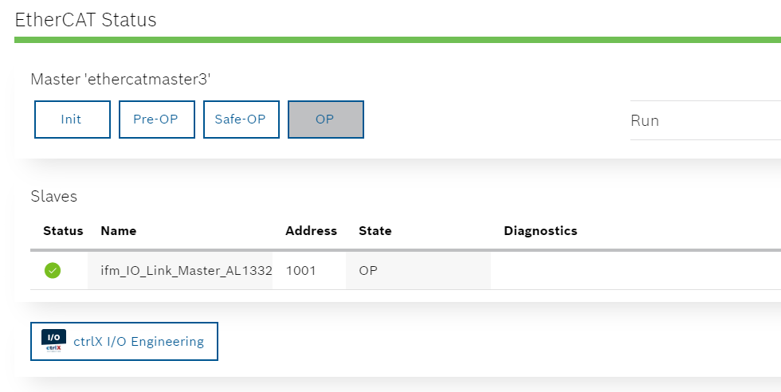
Establish a connection between IO-Link Master and ctrlX PLC
After saving and uploading the project to the PLC we should be in OP mode
© ifm ecomatic gmbh
Stand: 07.11.26
Seite <number>

Slide 11
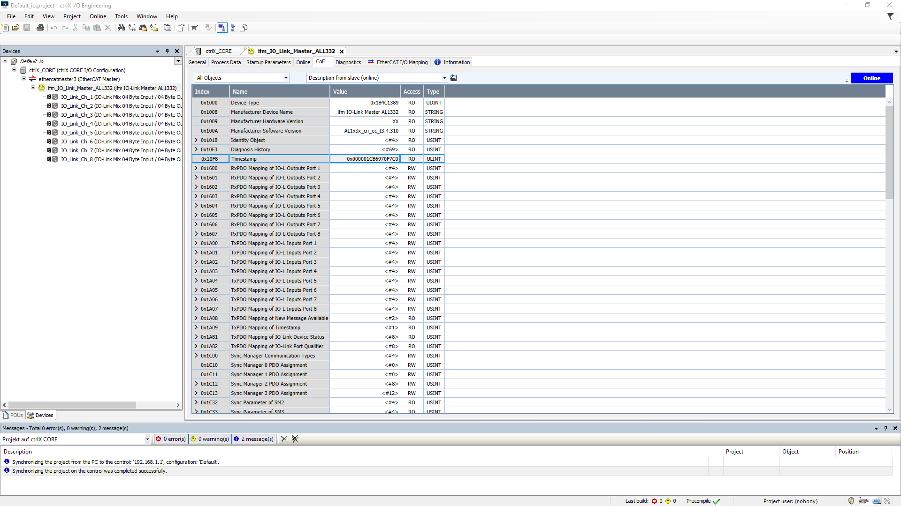
Exchange data via EtherCAT protocol
In ctrlX I/O Engineering we should be able to see values of the objects of IO-Link Master
© ifm ecomatic gmbh
Stand: 07.11.26
Seite <number>

Slide 12
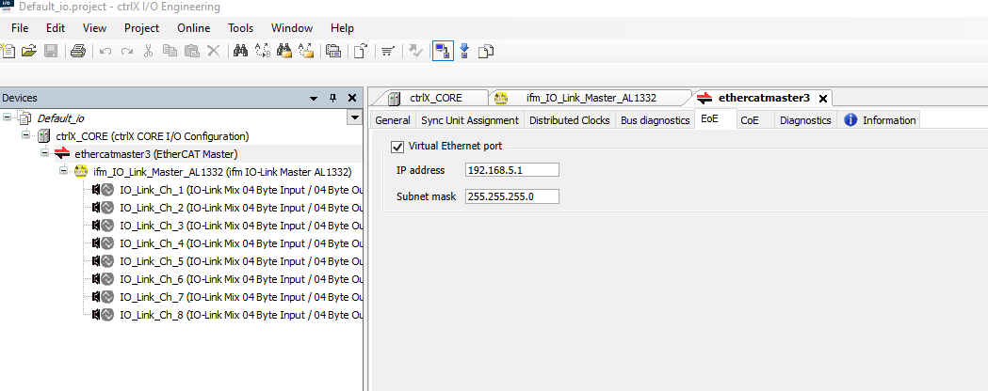
Use EoE – ctrlX I/O settings
We will start with the configuration in ctrlX I/O Engineering
First, EtherCAT Master EoE configuration will be set to:
© ifm ecomatic gmbh
Stand: 07.11.26
Seite <number>

Slide 13
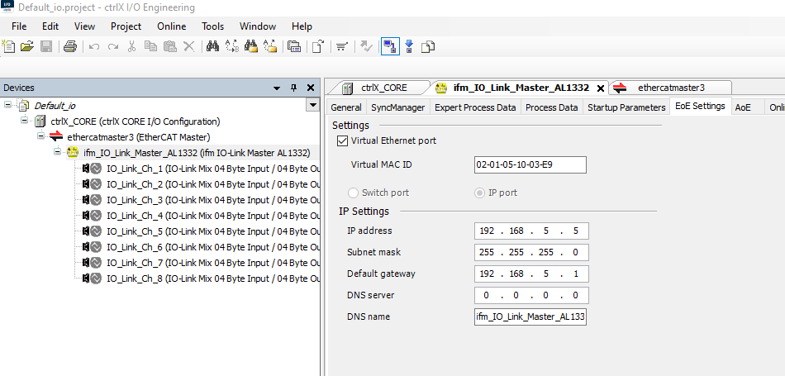
Use EoE – ctrlX I/O settings
Next, EtherCAT slave will have its Expert settings enabled – with this the EoE Settings tab will appear
EoE Settings tab should have the following content
We should now save our changes and upload this new configuration to the PLC
© ifm ecomatic gmbh
Stand: 07.11.26
Seite <number>

Slide 14

Use EoE – PC settings
Because our PC is connecting with PLC via the network 192.168.1.0 it is not aware that the network 192.168.5.0 exists
In order to let our PC know how to reach the 192.168.5.0 network we need to use routing
With the help of the command presented below we will make a non-persistent entry to the Windows routing table
route add 192.168.5.0 mask 255.255.255.0 192.168.1.1
© ifm ecomatic gmbh
Stand: 07.11.26
Seite <number>

Slide 15
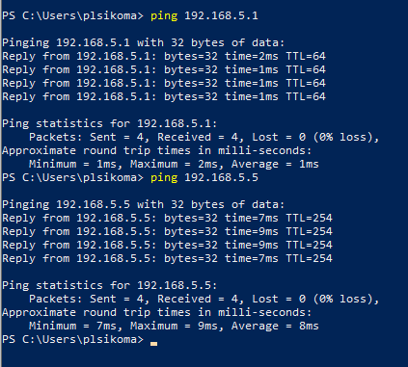
Use EoE – communication test
After the routing in Windows is set, we should be able to communicate with devices in the network 192.168.5.0. To test this, we can use ping
© ifm ecomatic gmbh
Stand: 07.11.26
Seite <number>

Slide 16
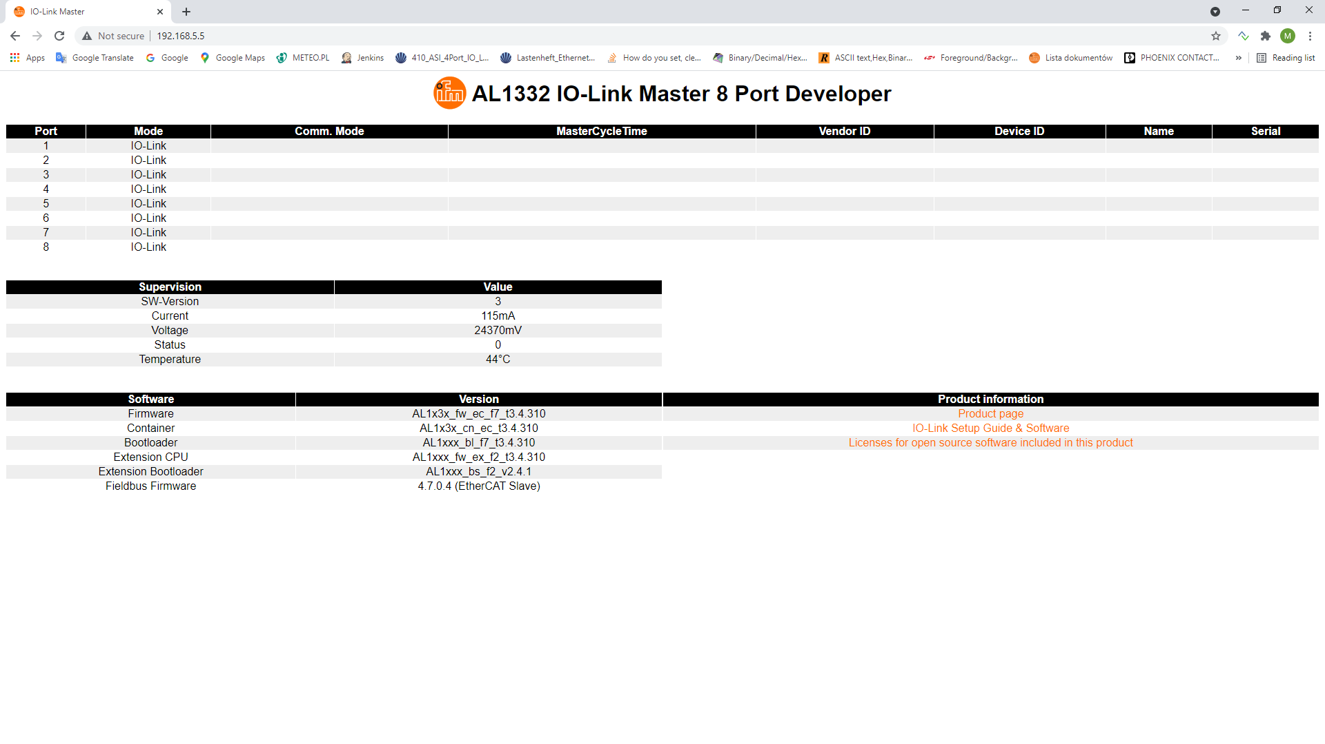
Use EoE – IO-Link Master webserver
Webserver of IO-Link Master will be now reachable from the PC
© ifm ecomatic gmbh
Stand: 07.11.26
Seite <number>

Slide 17
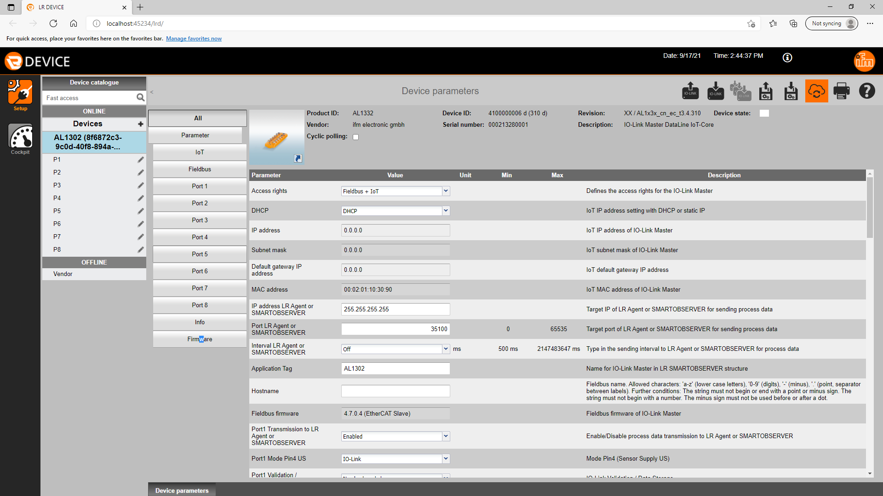
Use EoE – IO-Link Master LRD
IO-Link Master can now connect with LRD (it has to be manually added to the device list)
© ifm ecomatic gmbh
Stand: 07.11.26
Seite <number>

Slide 18
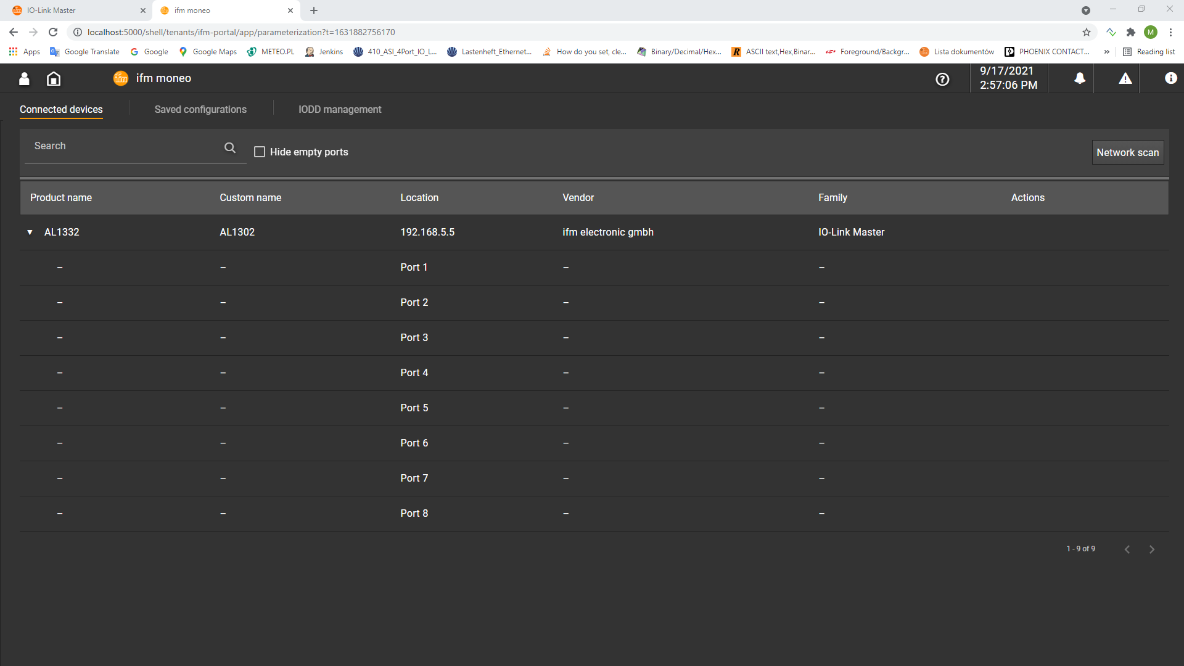
Use EoE – IO-Link moneo
IO-Link Master can now connect with moneo (it has to be manually added to the device list)
© ifm ecomatic gmbh
Stand: 07.11.26
Seite <number>

